Slide 1


Spatial Analysis course
Day 1

Slide 2
RStudio

Slide 3
What we will do:
Introduction to R and Rstudio
Tidyverse and other data-centric packages
Basic techniques of spatial analysis
Plot data
Create maps
Learn some basic notions of spatial data statistical models

Slide 4
What we will NOT do:
Learn advanced notions of how most spatial data statistical models work
Use = instead of <- as an assignment operator (Trump gets an extra vote whenever you do that)
Learn how to scrape data from websites
Have a final exam
…

Slide 5
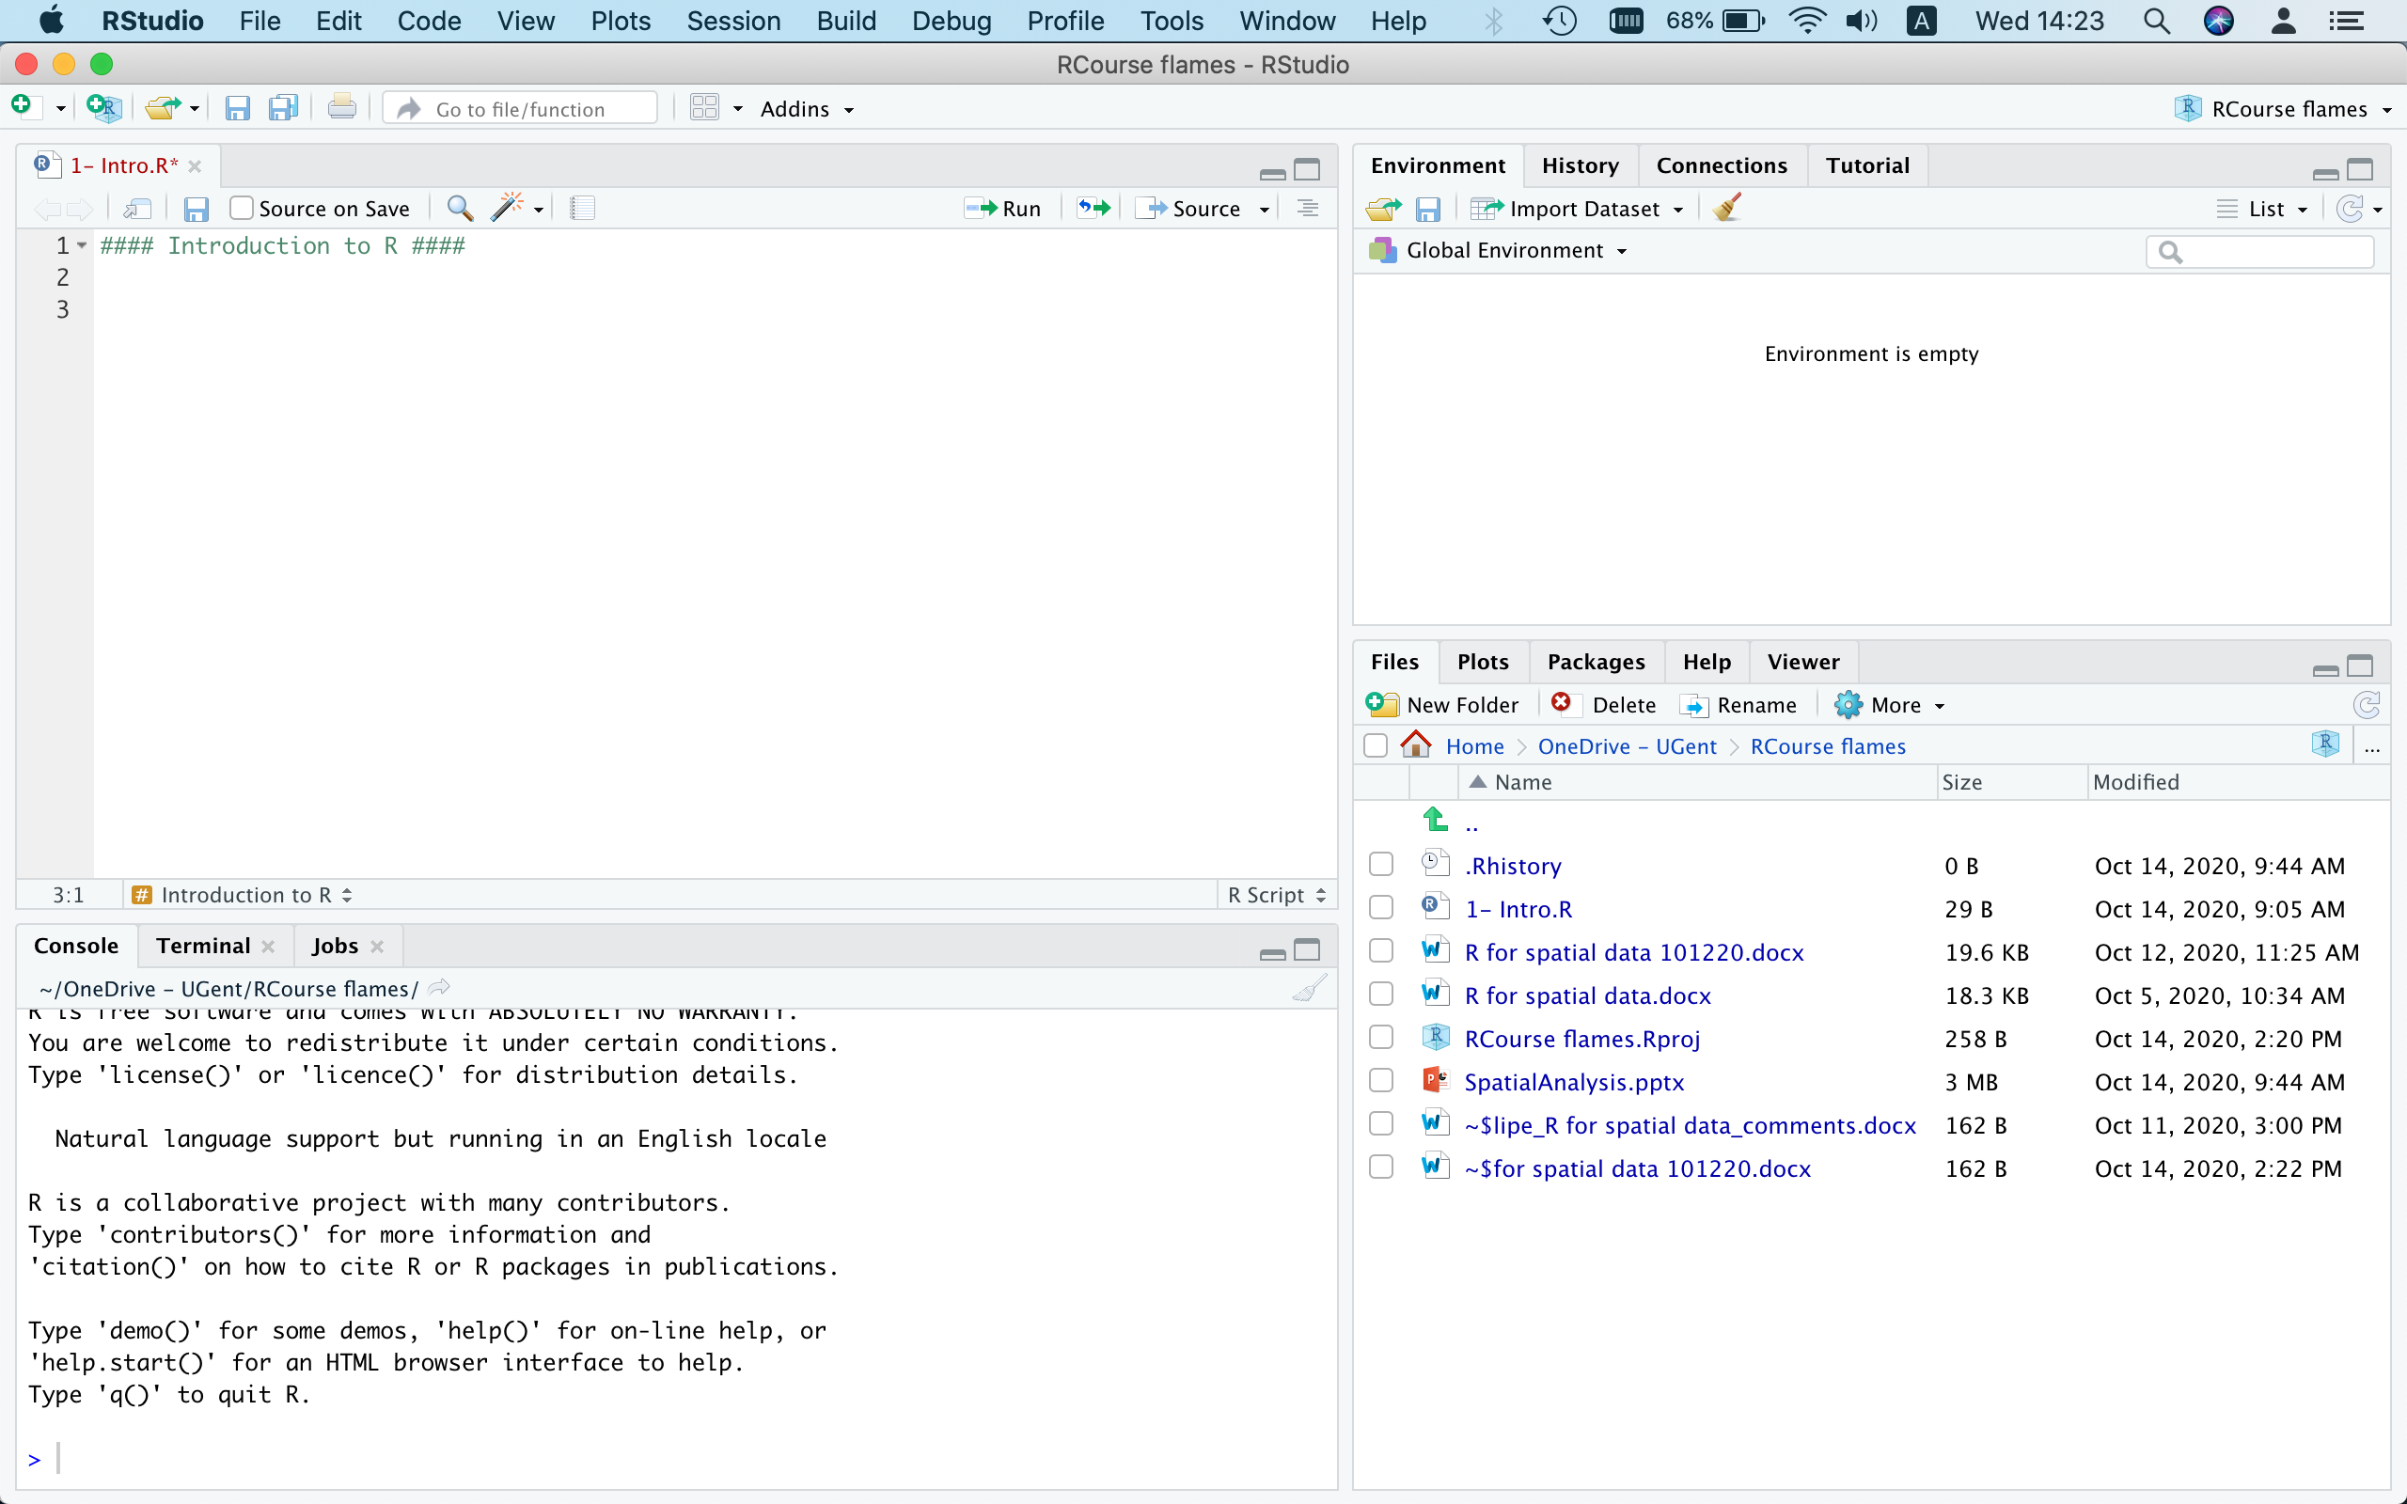

Slide 6
Environment
History
Connections
Tutorial

Slide 7
Script files
Data.frame overview

Slide 8
Console
Terminal
Jobs

Slide 9
Files
Plots
Packages
Help
Viewer

Slide 10
Projects

Slide 11
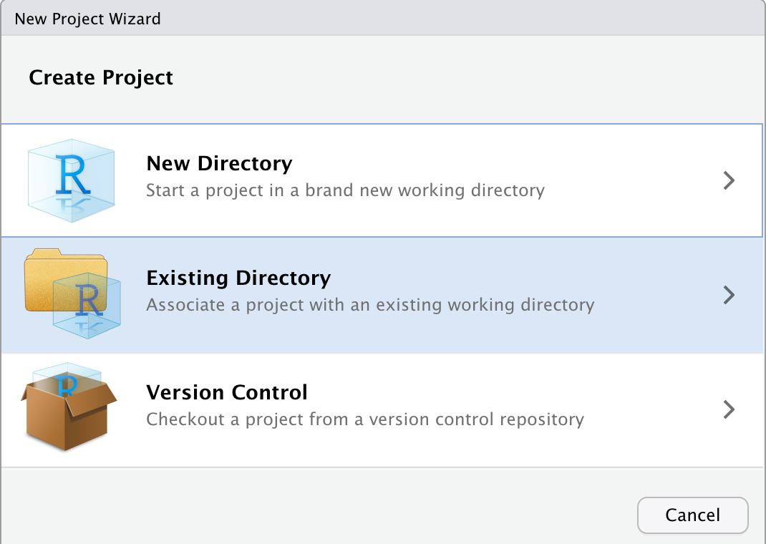
Projects help to manage rscript files and data.
If for example you’re writing some code and want to save some objects, then you can set up a project.
Without projects, your working directory for example is never saved, and any unsaved objects will be deleted after closing RStudio

Slide 12
1.c
Basic Data Values
(r script)

Slide 13
Basic Data Values
Numeric/Integer
Factors
1, 2, 3
3.141593
2.386421e+54
[1] A C D C A C D
Levels: A B C D (1,2,3,4)
Missing Values
Logical
NA
NULL
TRUE
FALSE
Date
"1969-07-20”

Slide 14
1.d
Basic Data Structures
(r script)

Slide 15
2.
tidyverse – Part I

Slide 16








2.
tidyverse

Slide 17
2.a
pipes
%>%

Slide 18
2.a
Tidyverse uses pipes to follow data
df %>%
filter(cities == “Tokyo”) %>%
summarise(population = sum(people))
cities | people (million) | country
Tokyo | 9.23 | Japan
Frankfurt | 0.73 | Germany

Slide 19
2.a
Tidyverse uses pipes to follow data
df %>%
filter(cities == “Tokyo”) %>%
summarise(population = sum(people))
cities | people (million) | country
Tokyo | 9.23 | Japan
Frankfurt | 0.73 | Germany

Slide 20
2.a
tibbles

Slide 21
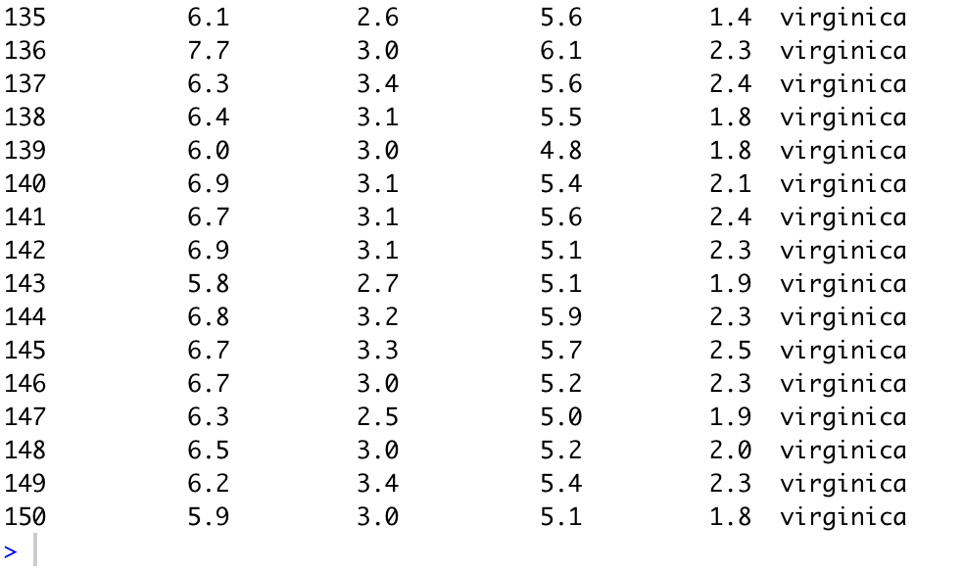
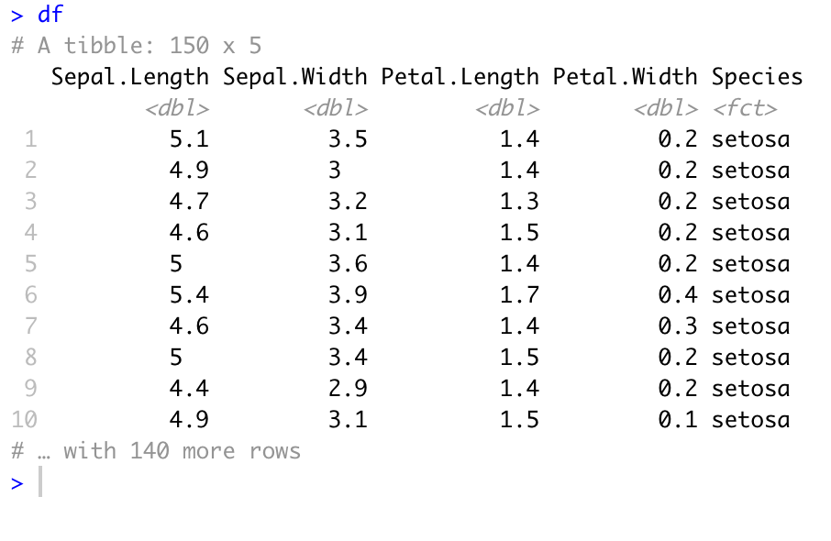
2.A - printing
data.frame
tibble

Slide 22
2.a
tibbles
(r script)

Slide 23
Thank you

